Slide 1
SDS OVERVIEW TRAINING GUIDE
By Patrick Kirui / Philip Nderitu

Slide 2
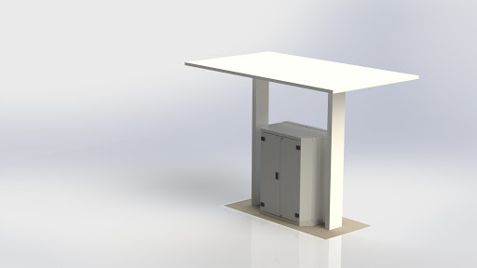
SDS

Slide 3

THE SCOPE OF THE TRAINING
Provide general overview of our complete Smart Depot System(6d)
Provide general overview of all electrical components used to make the Smart depot System
Provide general overview of all mechanical components inside the Smart depot system

Slide 4
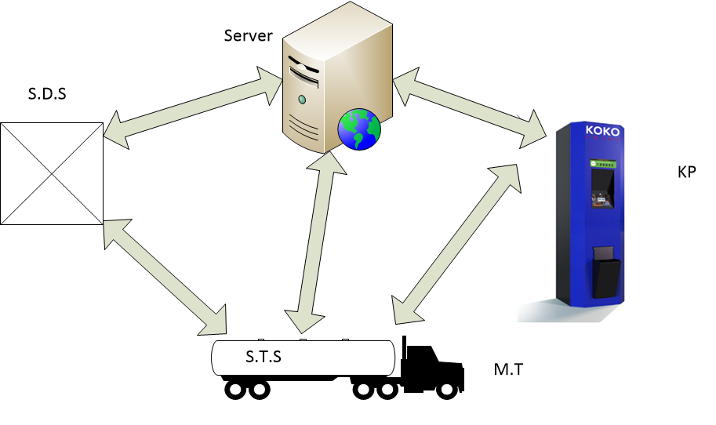
The SDS (smart depot system)
The SDS system is remotely monitored from the depot control centre DCC used to control the transfer of fuel (Ethanol) from the UST to the micro-tanker (MT).
MT

Slide 5
SDS Electrical Components
Smart Depot Controller V4.1(SDC)
Voltage Stabilizer SVS
Twin Socket
Contactor 240V
Modem-RUT950
Tablet 14”
Control box Enclosure
System ON/OFF Rocker Switch-DPST
UPS 12V 5A
12V 7AH Battery
Isolator switch

Slide 6
SDS plumbing Components
1.Pump(fill-Rite)
2.Hose Reel(Roughneck)
3.8pcs of 1 Inch Nipples(SS-304/320)
4.3pcs of 1 inch elbow(SS-304/326)
5.1pc of 1 inch Non-Return Valve(SS-304/323)
6.1pc of 1 inch Y Strainer(SS-304/323)
7.1pc of 1 inch 3 piece union(SS-304/321)
8.Tuthill flow meter
9.Dispense Valve(Solenoid)
10.Swivel End Hose Reel.
11.PTFE thread tape/PST pipe sealant

Slide 7
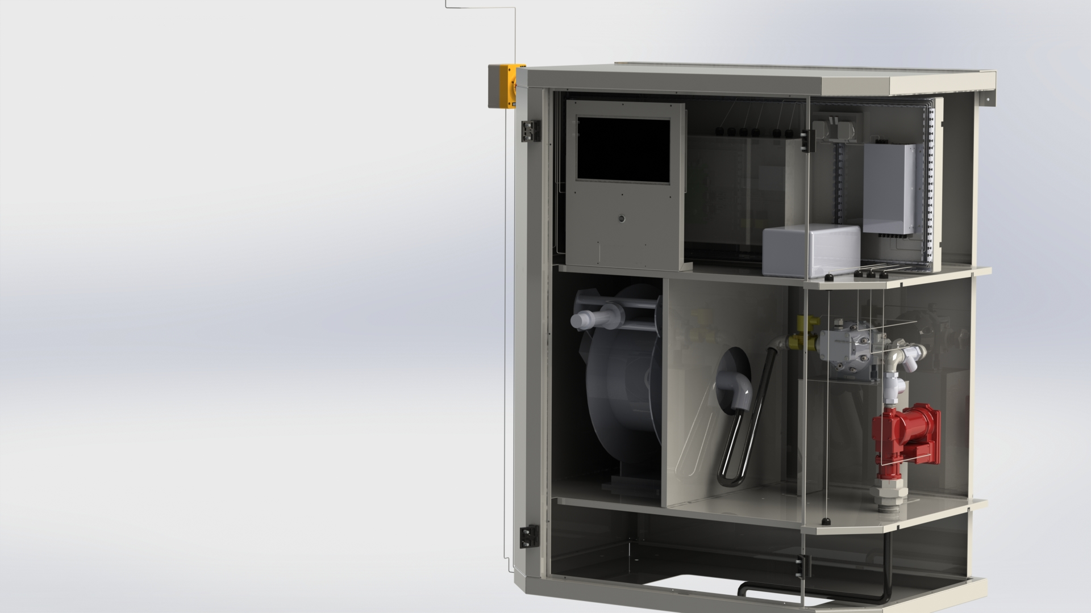
SDS INTERNAL COMPONENTS
Isolator Switch
Twin socket
Tablet
Ac to Dc converter
Voltage stabilizer
Control Box
Tuthill Flow Meter
Hose reel
Pump

Slide 8
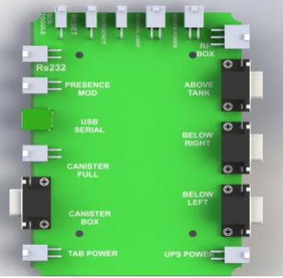
Smart depot controller(sdc) v4.1
SDC provides communication between SDS hardware and the server/user through the tablet.

Slide 9
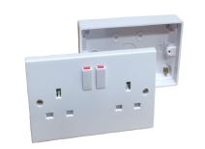
AC TWIN SOCKET
Receives power from the main power supply
It has a 13A fuse inside
It distribute power to both UPS and the pump

Slide 10
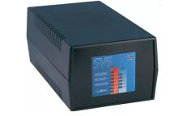
Voltage stabilizer
Provides the desired voltage output entering into the SDS by eliminating voltage fluctuations

Slide 11
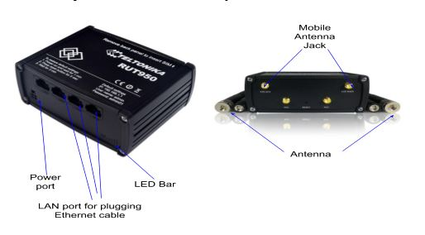
Modem RUT950
Provides internet connectivity to the SDS tablet

Slide 12
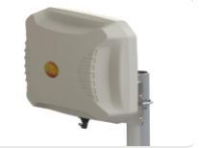
MODEM ANTENNA
Help to boost SDS modem signals through signal amplification
It is connected to the modem antenna ports

Slide 13
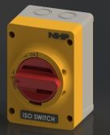
ISOLATOR SWITCH
Use to isolate overall SDS power. Its key purpose is to provide safety measures in case of an emergency or when you want to turn the whole system off.

Slide 14
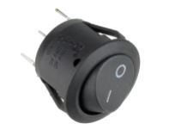
System on/off rocker switch
Used for rebooting or shutting down of the SDC

Slide 15
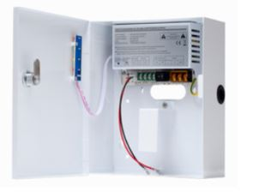
Ups 12v 5A
UPS allows our SDC to keep running for at least a short time when the primary power source is lost. It also provide protection from power surges. It has 12v 7AH battery inside.

Slide 16
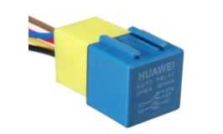
contactor
It controls SDS pump power
Usually connected on a normally open circuit and triggers the pump to run every time it receives signal from the SDC.

Slide 17
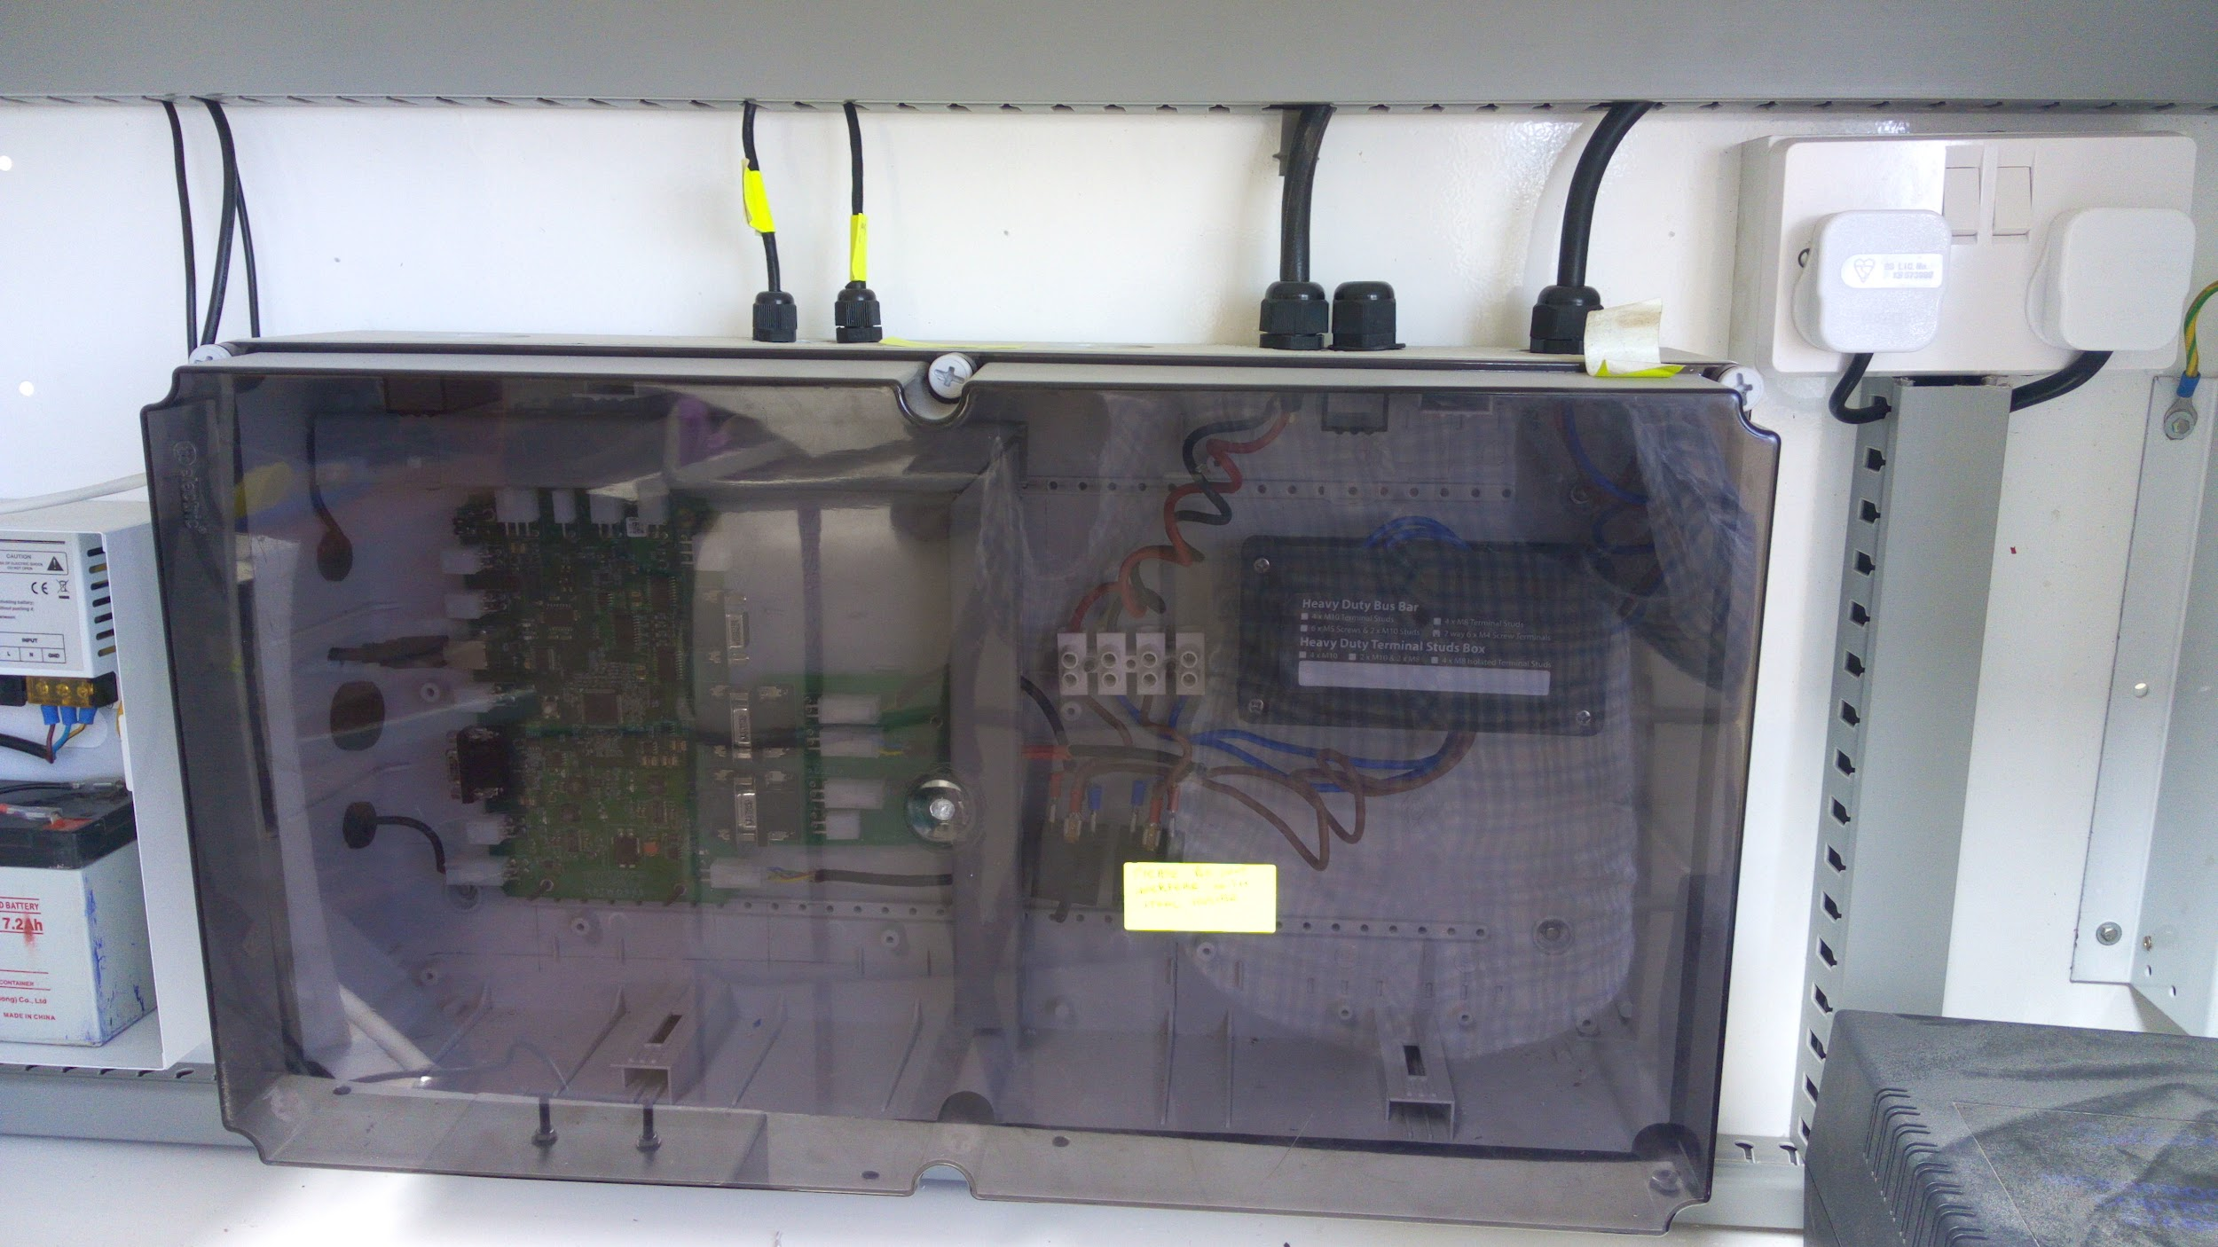
SDS Control box
It houses the SDC, Contactor, flowmeter pcb, pump pcb and all their wiring.

Slide 18
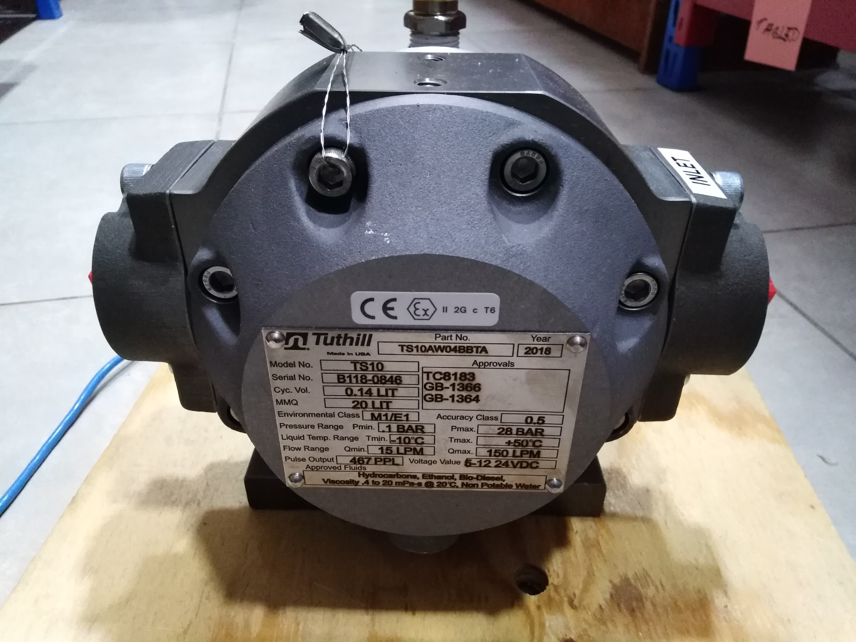
TUTHIL FLOW METER
It measures the amount of fuel flowing from Depot storage tank into the tanker through SDS system.
Flow meter

Slide 19
Other components
Calibration Box
Used to hold calibration pcb
Ethanol sensor
It detects ethanol fumes in case of any leakage inside the SDS housing.
UST sensor converter box
It holds signals and power line for the UST sensor.
UST sensor
It detect the level of fuel inside the underground tank

Slide 20
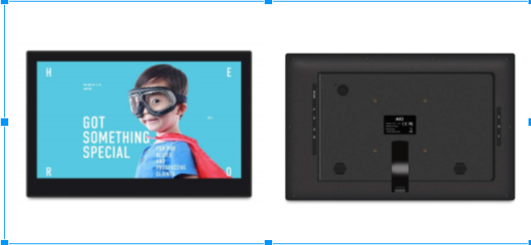
TABLET
Tablet initiate all the processes of a smart depot system. It acts as a link between the user and the hardware or between the hardware and the server.

Slide 21
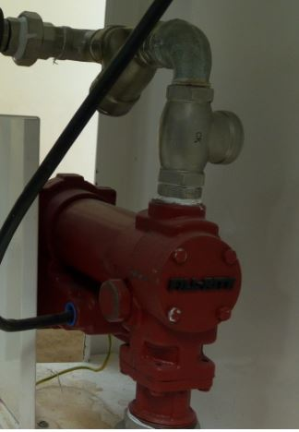
Pump Assembly
Its an electro mechanical component powered with 240V used for transfer of ethanol from the Underground Storage Tank(UST) to the Microtanker.

Slide 22
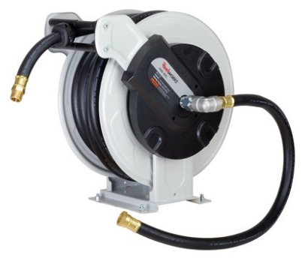
Hose Reel Mounting
The hose Reel specifications
REELWORKS Heavy Duty Spring Driven Hose Reel (1" x 50 Ft. NBR FUEL REEL)

Slide 23
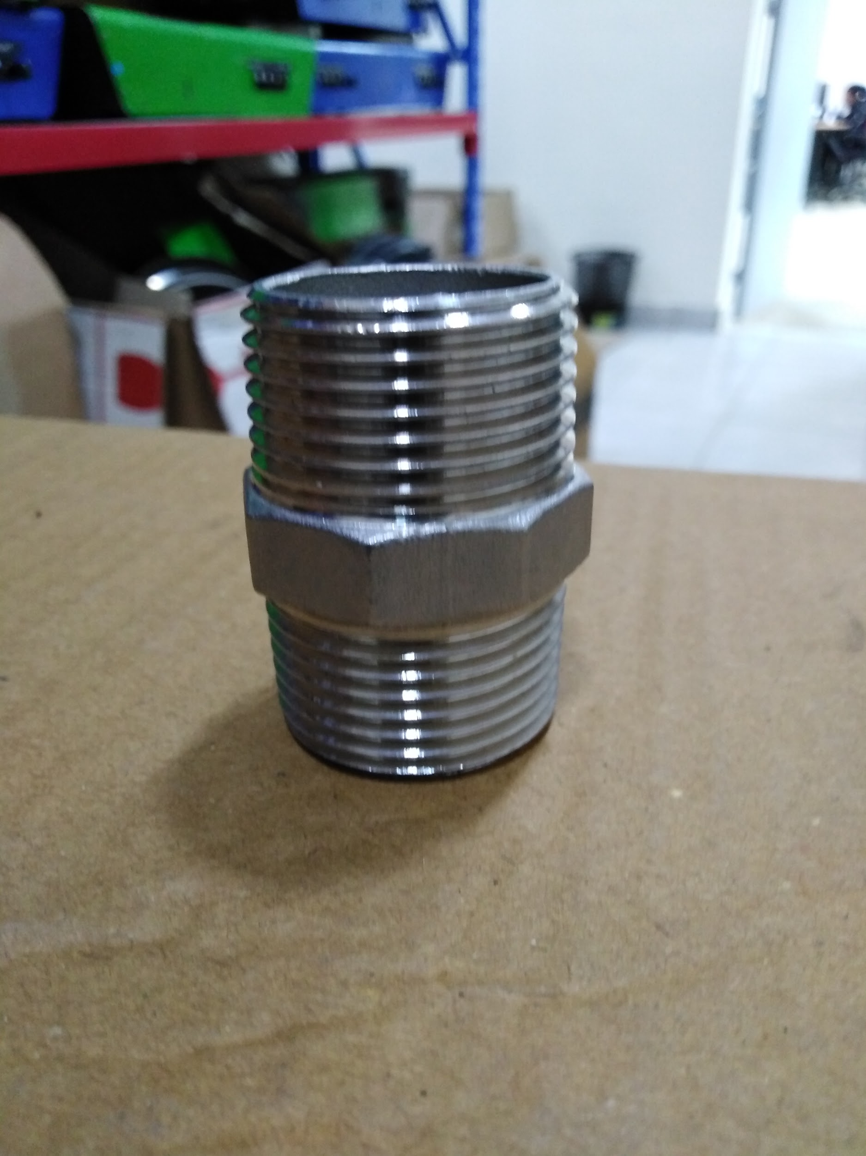
Dispense column Assembly
Take all the required components as follows:Nipple, One way valve, Nipple,Elbow, Nipple,Strainer, Nipple, Elbow, Nipple, 3 piece union, Nipple,Flow meter, Nipple, Nipple, Elbow, Swivel end hose reel.
A nipple is a connector joining two different fittings.

Slide 24
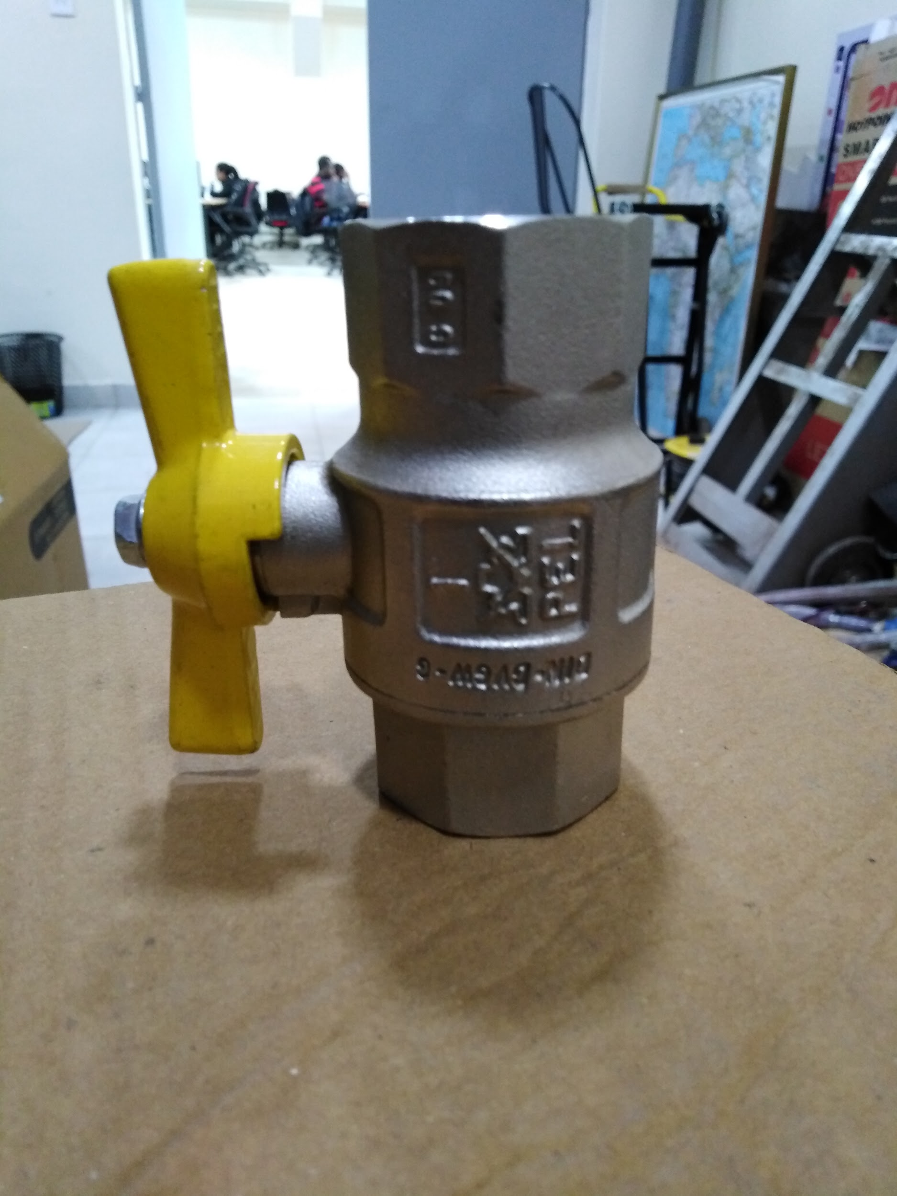
Manual Valve
Its a mechanical fitting that works as a cut off system during a flow or a dispense and is manually operated.

Slide 25
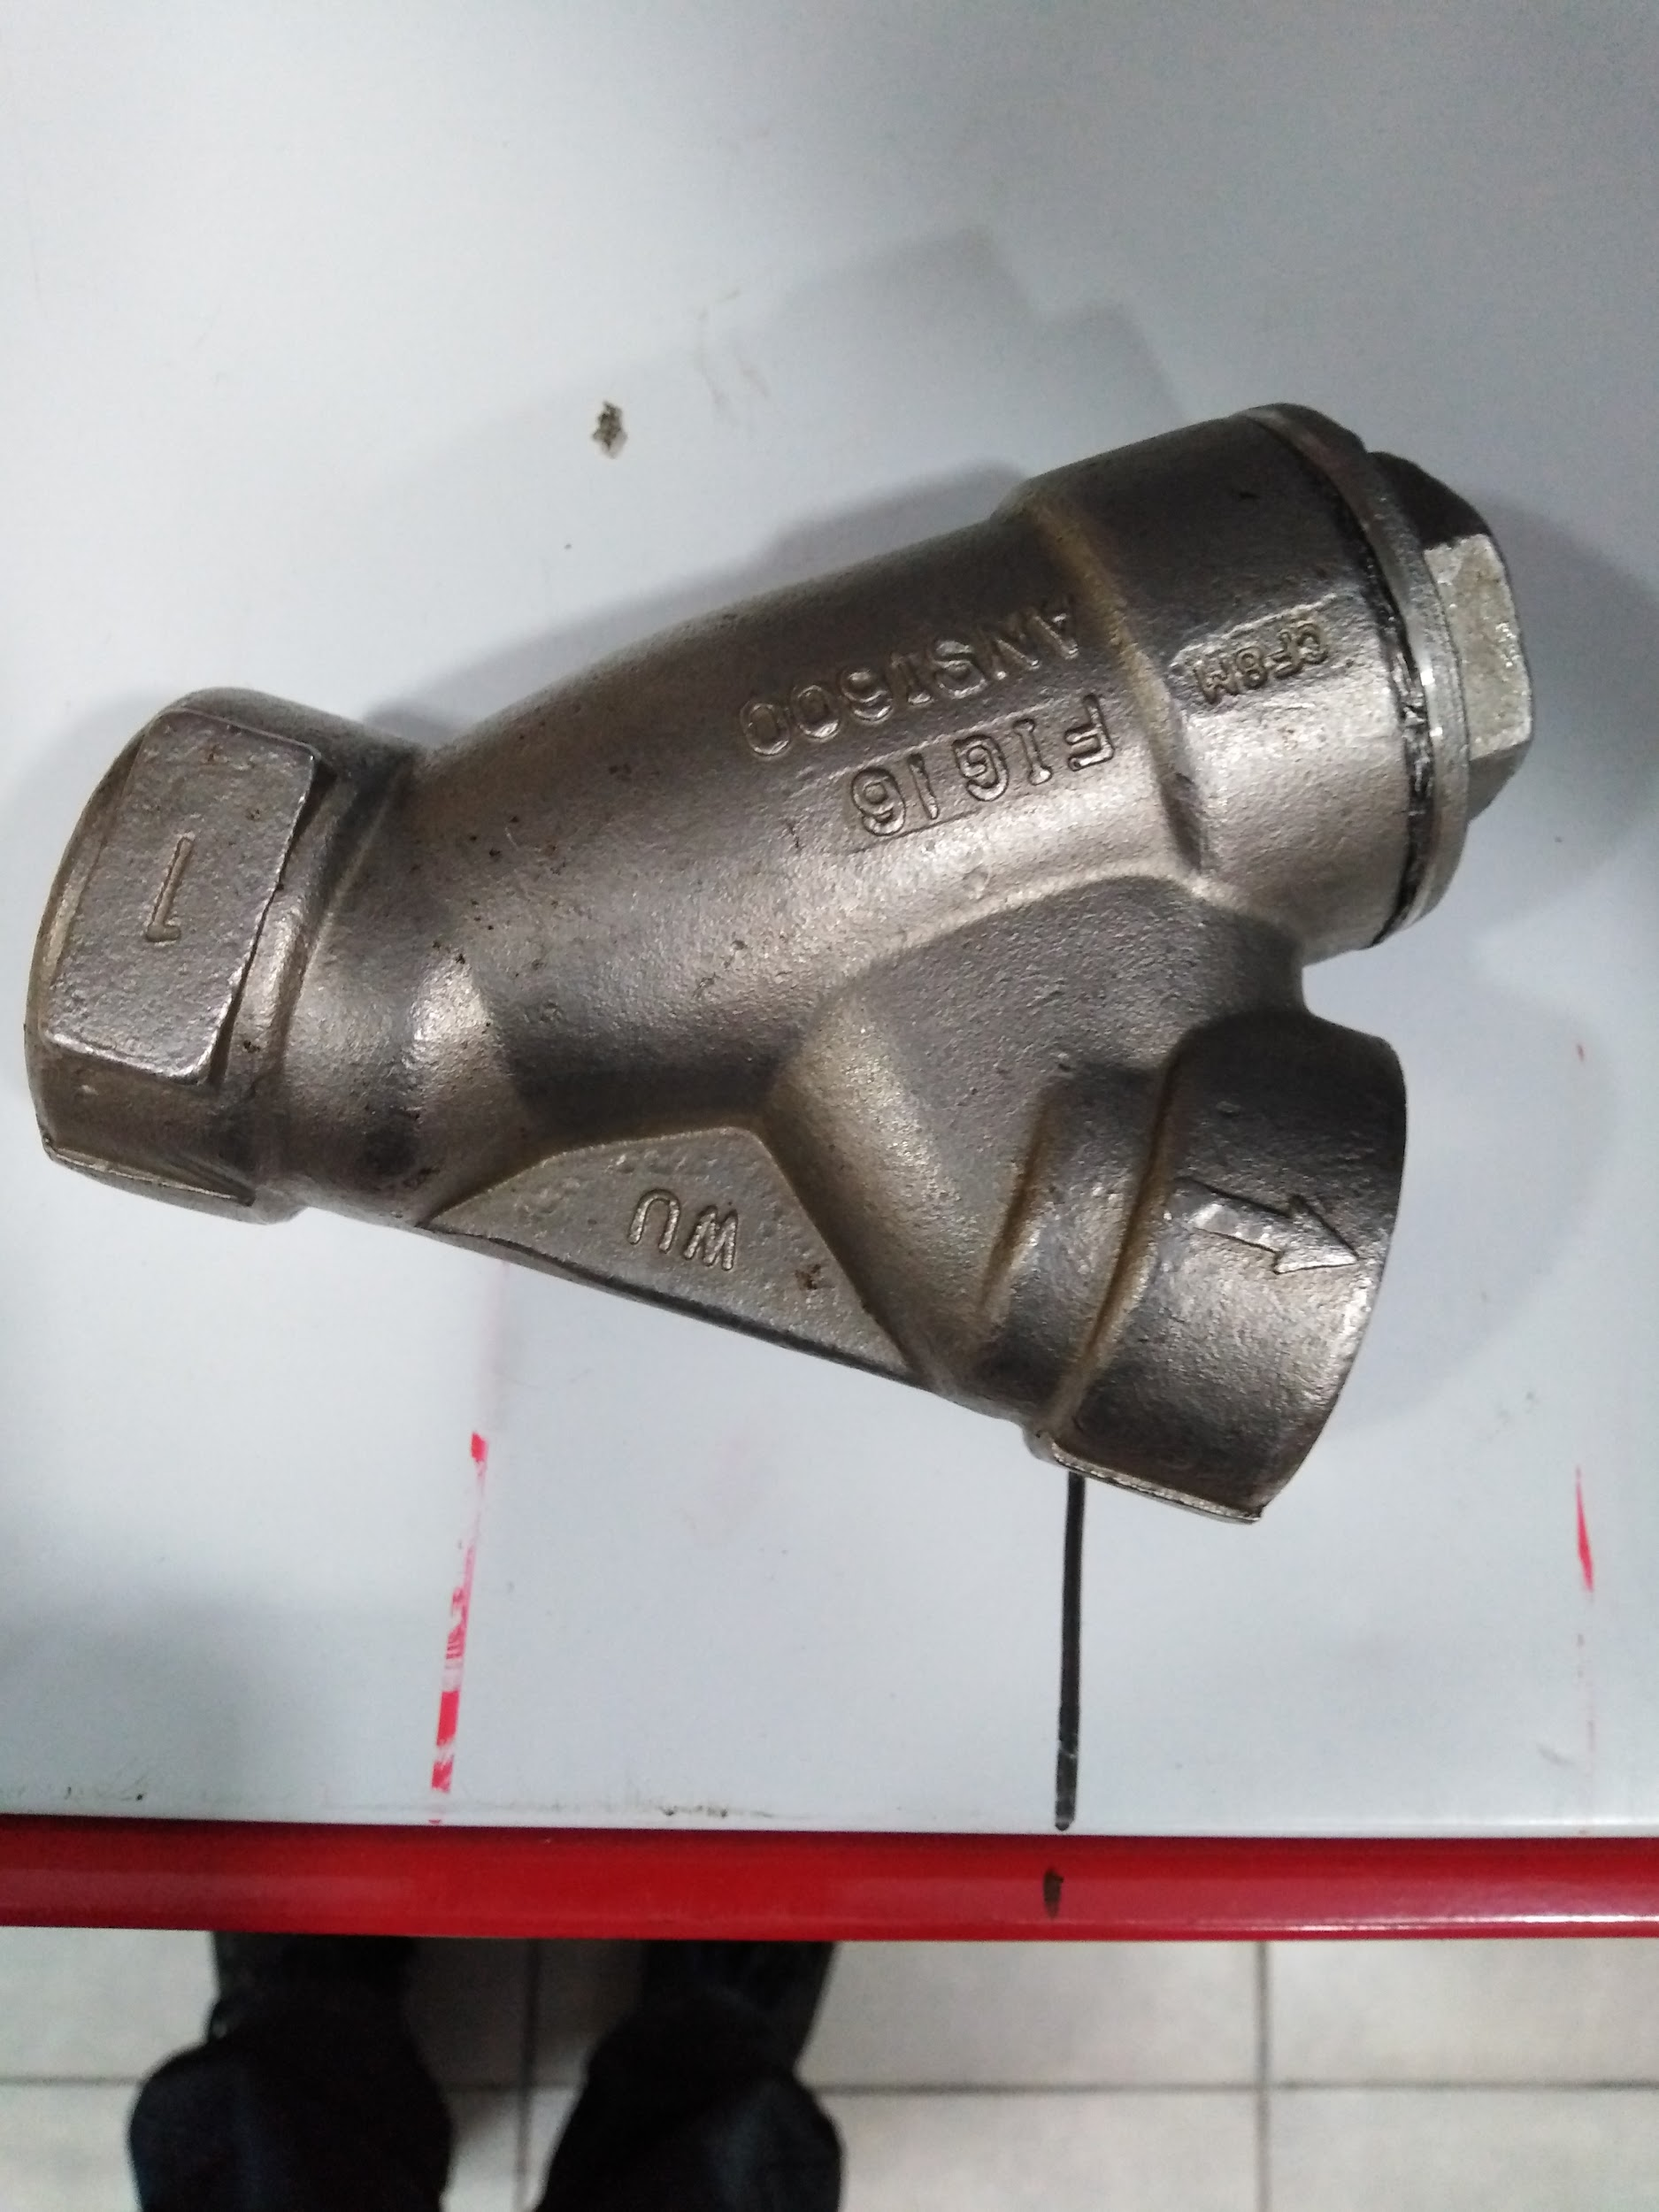
Y Strainer
As the name suggests it has a small strainer intersecting the main channel that traps foreign particles and has an arrow marked showing the direction of flow.

Slide 26
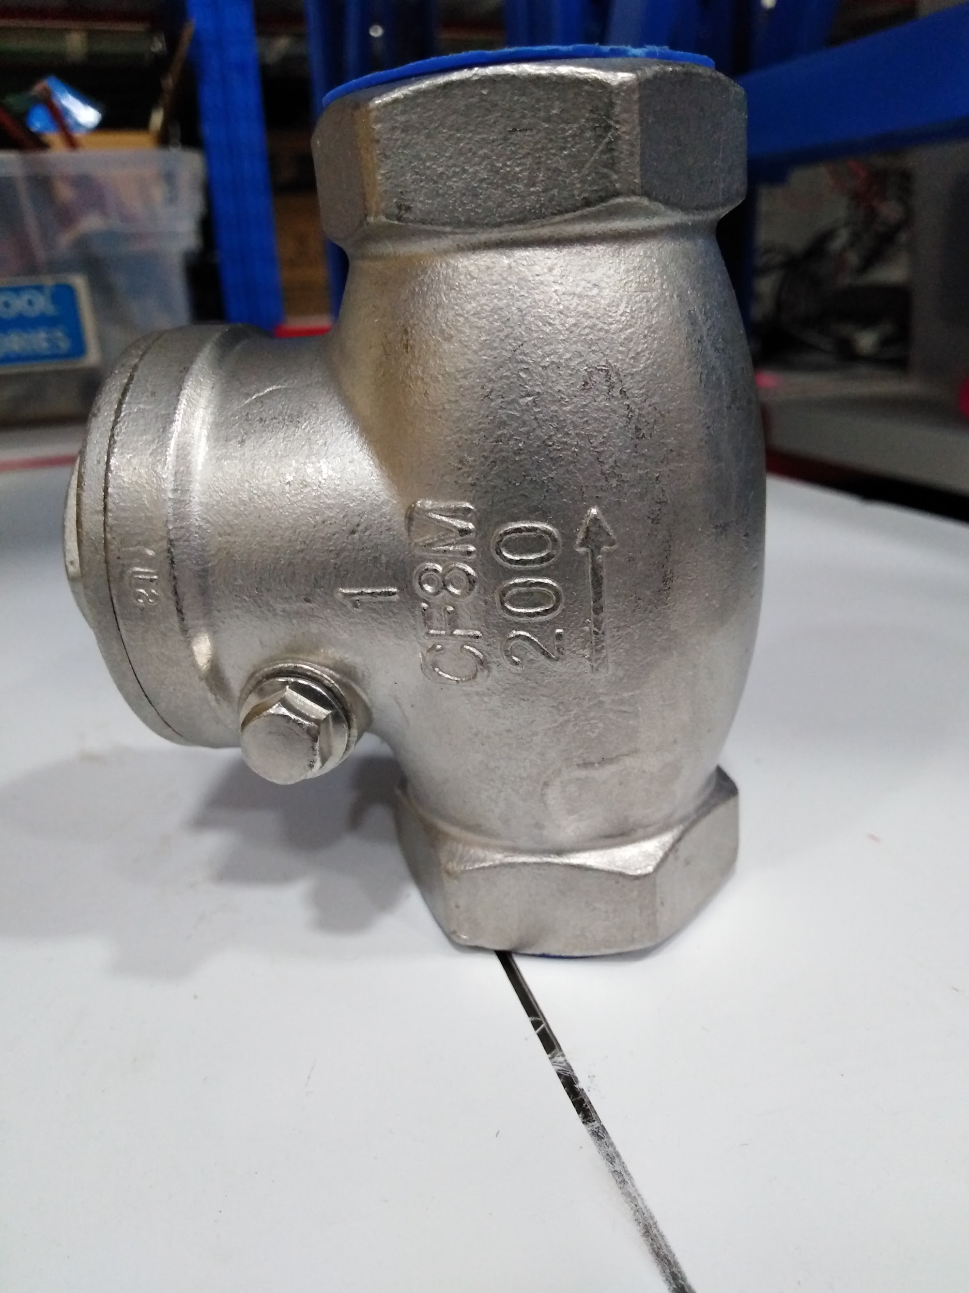
One Way Valve
It's a fitting that allows the flow of fluid in only one direction as the name suggests and some call it a Non-Return Valve

Slide 27
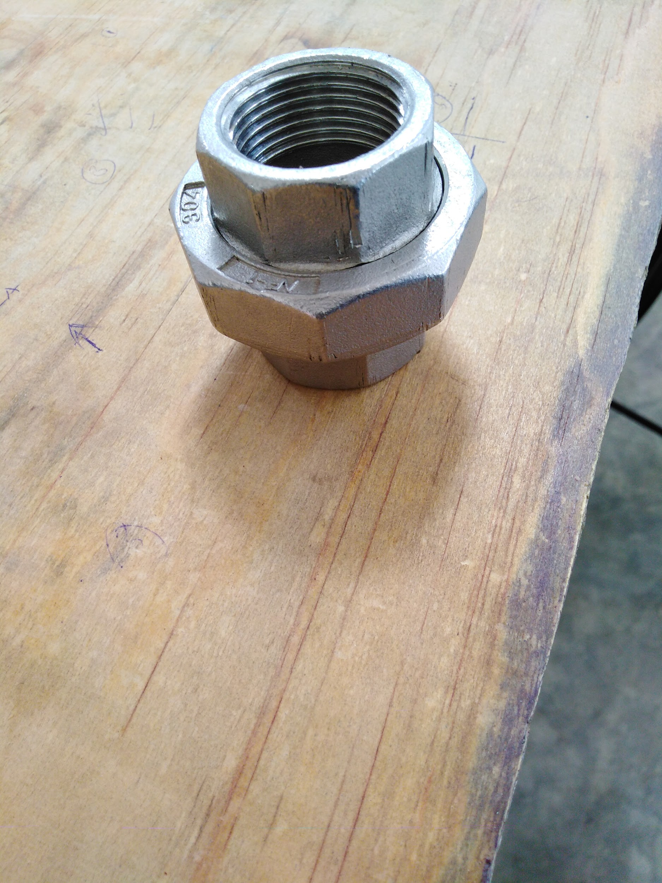
3 piece union
A Female x Female component with a radial nut used to join two fittings

Slide 28
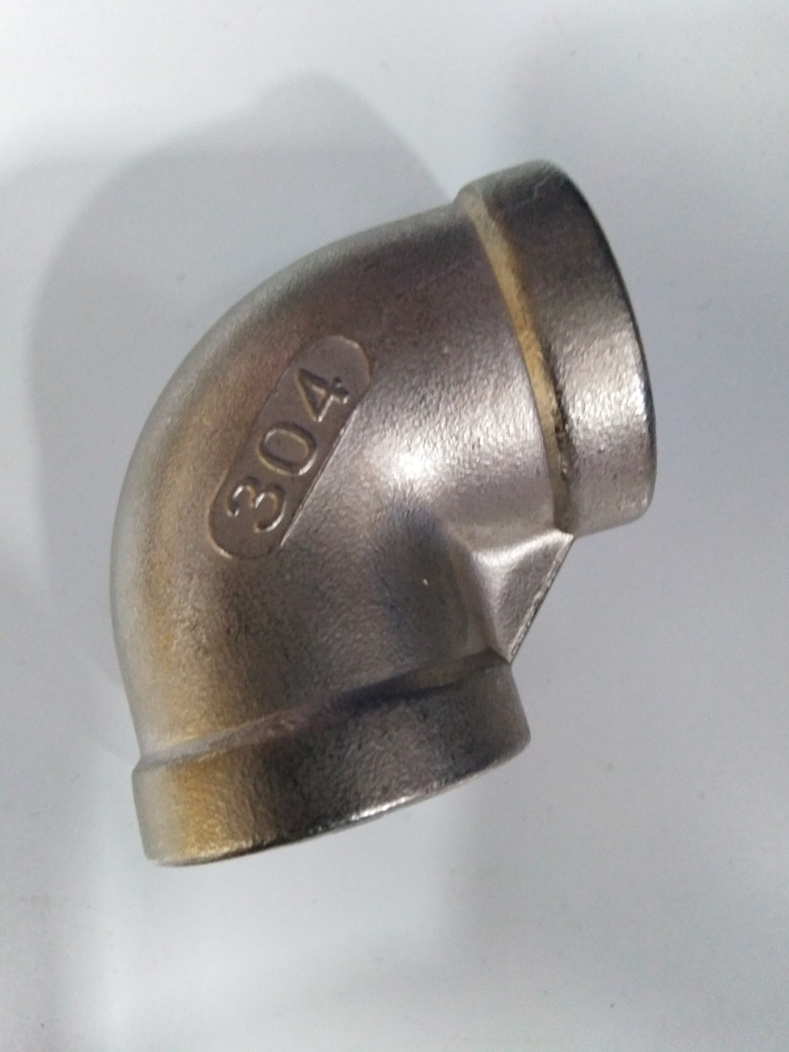
Elbow
An elbow is an industrial fitting that's used to change direction of flow in piping.

Slide 29
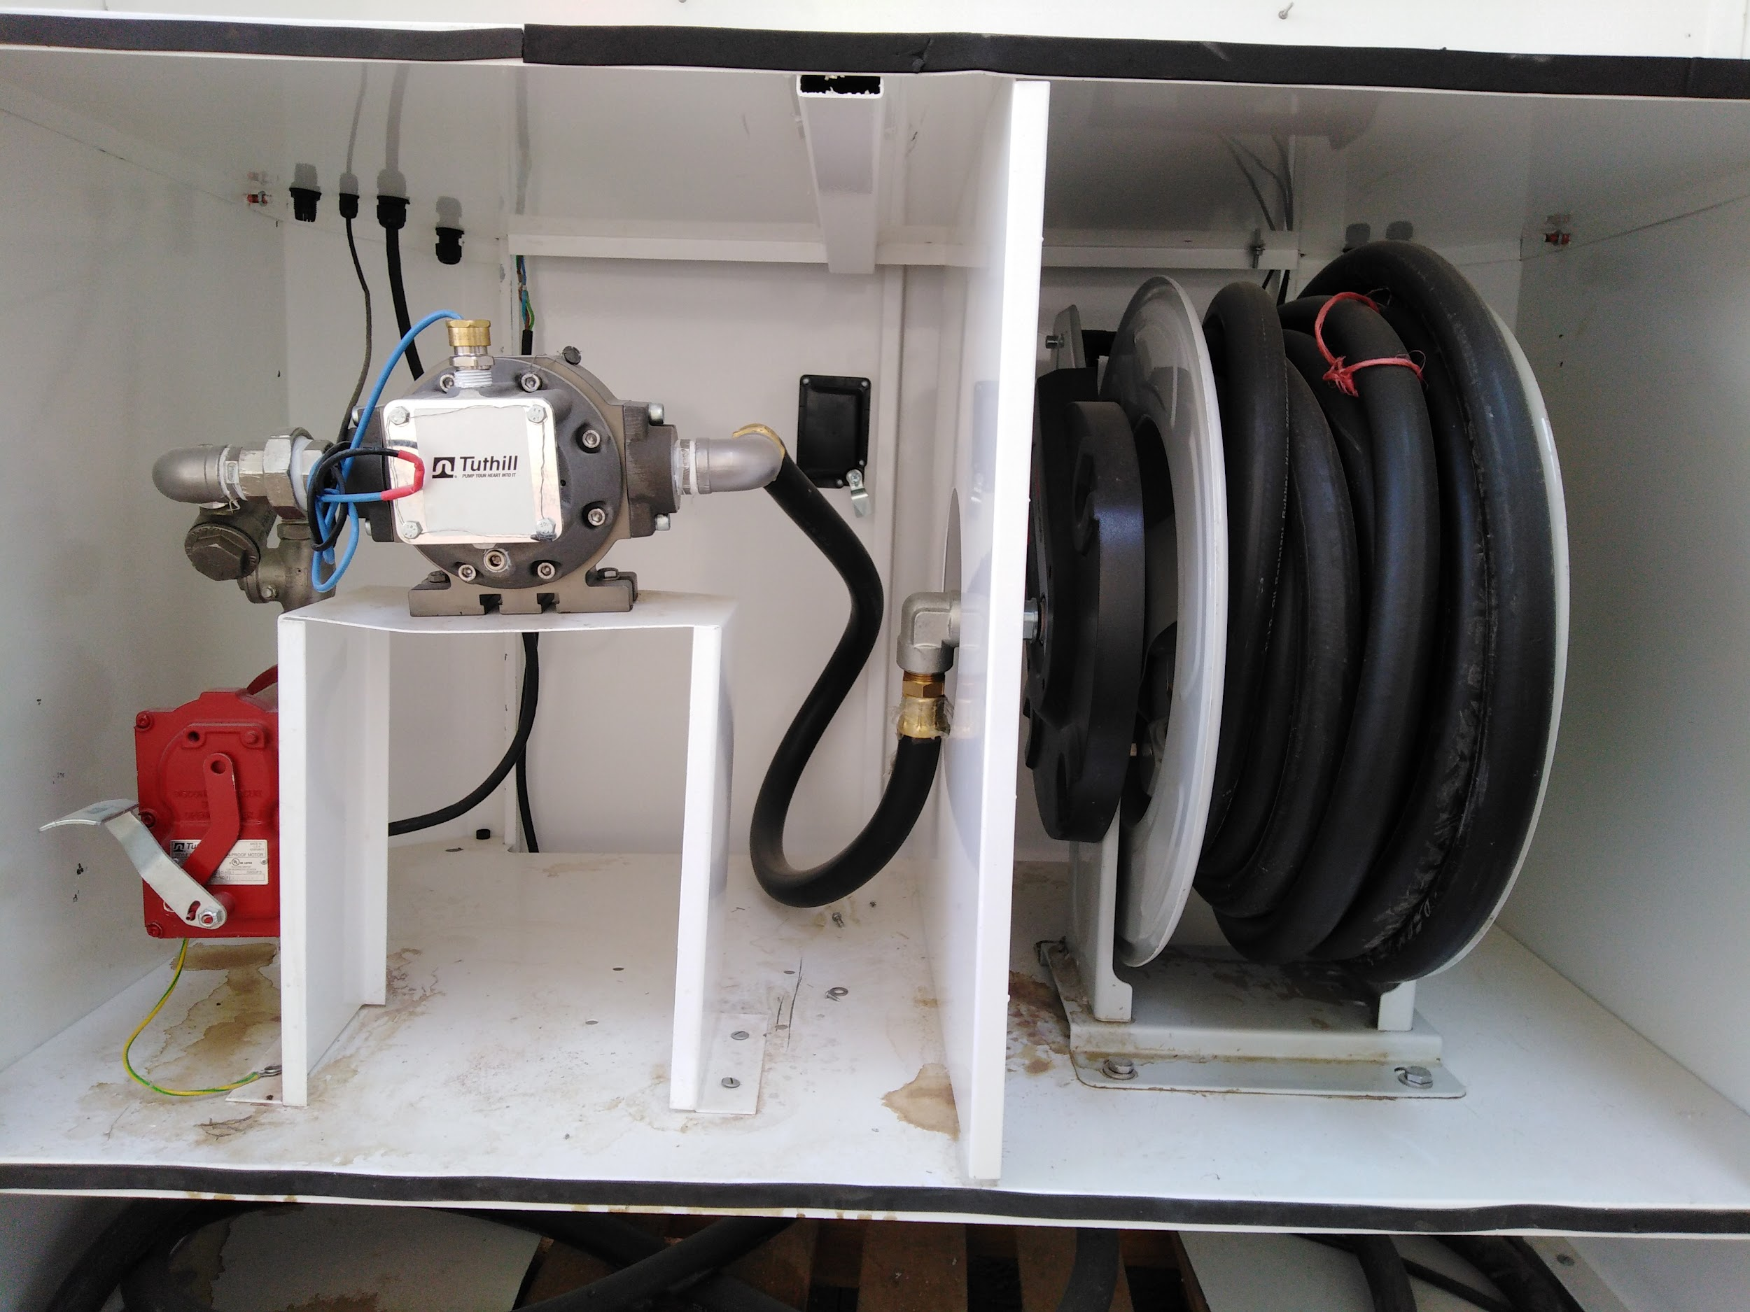
Dispense Column Unit

Slide 30
TOOLS USED DURING ASSEMBLY
Adjustable Spanner
Pipe wrench
Bench Vise
Screw Drivers, Star & Flat
Tester
Digital multimeter

